Slide 1
Access Time:
0.25ns – 1ns
1ns – 5ns
5ns – 25ns
25ns – 100ns
3ms – 10ms
10ms – 2000ms
Size:
256B- 8KB
16KB-64KB
1MB-4MB
4GB-256GB
500GB+
HUGE
Registers
L1 Cache
L2 Cache
Main Memory (RAM)
Hard Disk
Network (The Cloud)

Slide 2
7 | 20 | 33
2 | 3 | 6
13
22 | 30
44

Slide 3
B.
C.
20
2 | 3 | 6
19 | 21
E.
D.

Slide 4
22 | 30
7 | 20
33 | 37
2 | 3
13
22 | 30
35
44

Slide 5
7 | 20 | 33
2 | 3 | 6
13
22 | 30
44

Slide 6
10
1 | 2
11 | 13
12
14

Slide 7
10
1 | 2
9 | 13
12
14

Slide 8
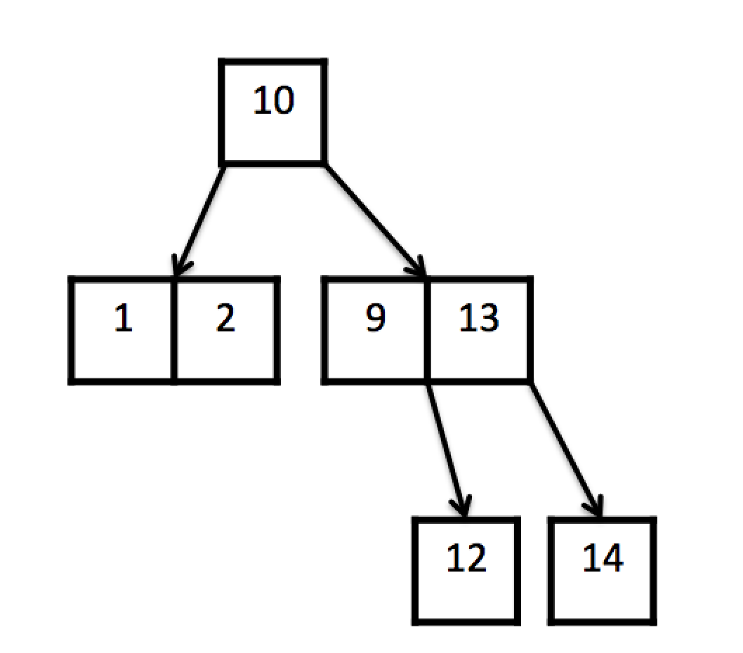
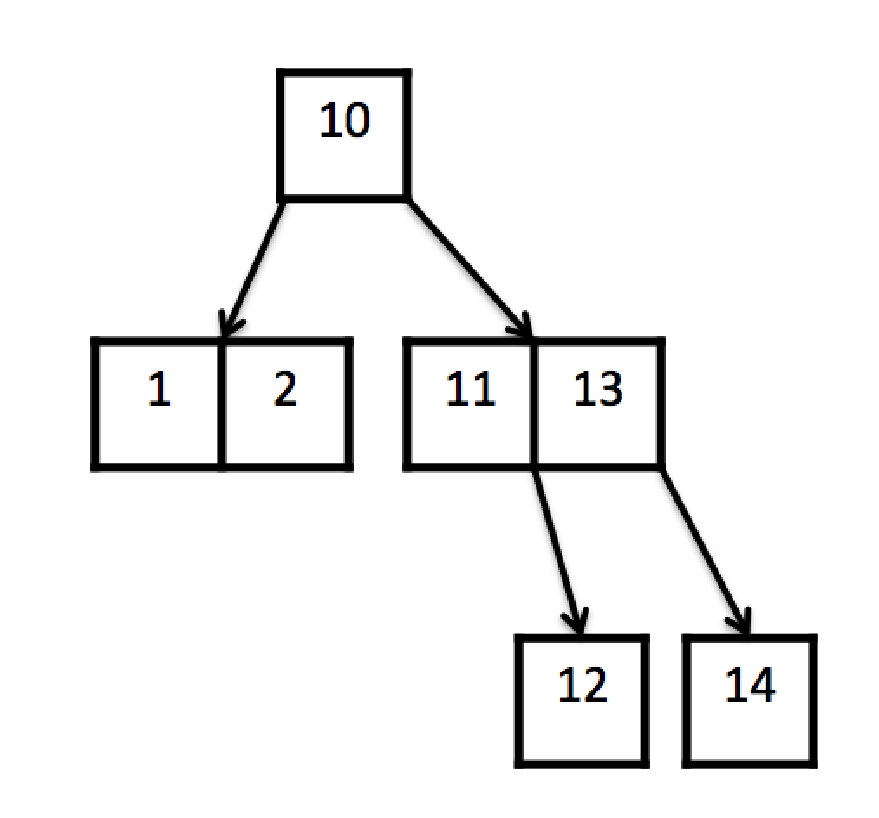
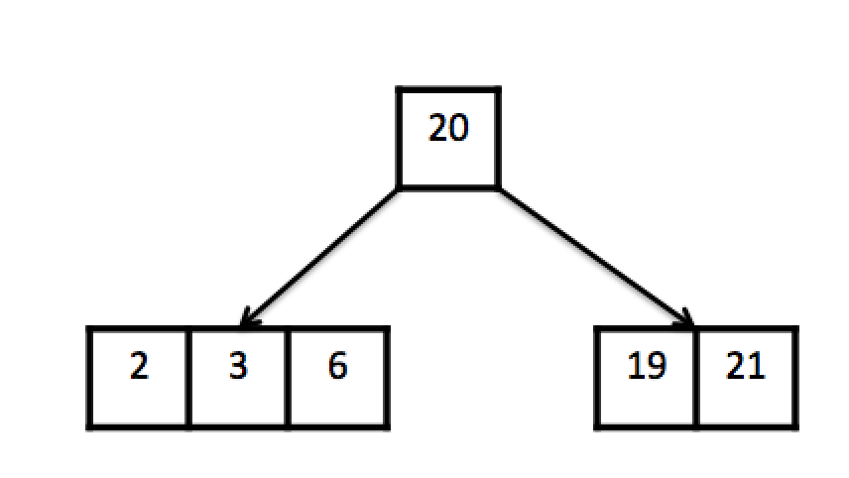
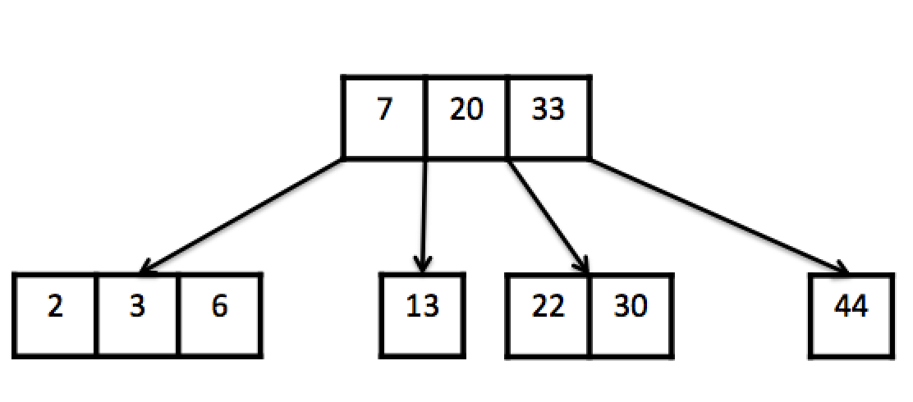
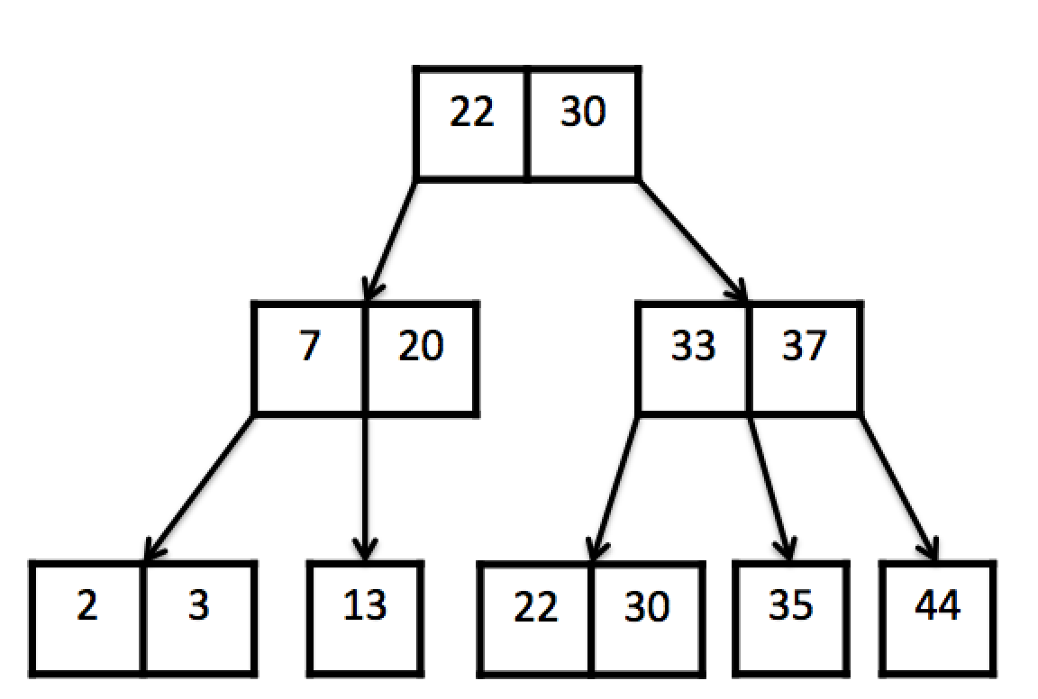
A.
B.
C.
D.
E.

Slide 9
Insert 7
7
Insert 10
7 | 10
Insert 1
1 | 7 | 10

Slide 10
Insert 4
1 | 4 | 7 | 10
Node is too large!
Cut the node
1 | 4 | 7 | 10
4
Grow the tree
1
7 | 10

Slide 11
4
Insert 11
1
7 | 10 | 11

Slide 12
Insert 12
4
Node is too large!
1
7 | 10 | 11 | 12
4
Cut the node
1
7 | 10 | 11 | 12
Grow the tree

Slide 13
4
Cut the node
1
7 | 10 | 11 | 12
4 | 10
Grow the tree
1
7
11 | 12

Slide 14
Current Tree:
4 | 10 | 12
1
7
11
13 | 14 | 15

Slide 15
Insert: 16
4 | 10 | 12
Node is too large!
1
7
11
13 | 14 | 15 | 16
4 | 10 | 12
Cut the node
1
7
11
13 | 14 | 15 | 16

Slide 16
4 | 10 | 12
14
Grow the tree
1
7
11
13
15 | 16
4 | 10 | 12
14
Node is too large!
1
7
11
13
15 | 16

Slide 17
4 | 10 | 12
14
Cut the node
1
7
11
13
15 | 16
10
4
12 | 14
Grow the tree
1
7
11
13
15 | 16

Slide 18
20, 2 , 22 , 23 , 27 , 30
23, 2, 20, 22, 20, 27
2, 22, 27, 23 , 30, 20
20 | 23
2
22
27 | 30

Slide 19
10
Delete: 17
4
12 | 15
1
7
11
13 | 14
16 | 17
10
4
12 | 15
1
7
11
13 | 14
16

Slide 20
10
Delete: 15
4
12 | 15
1
7
11
13 | 14
16
10
Fill the Empty Key
4
12
1
7
11
13 | 14
16

Slide 21
10
4
12 | 14
1
7
11
13
16

Slide 22
Delete: 24
21 | 27
1 | 2
24
30
21 | 27
Fill the Empty Key
1 | 2
30
NO!

Slide 23
21 | 27
1 | 2
30
2 | 27
1
21
30

Slide 24
Delete: 30
21 | 27
1 | 2
24
30
21 | 27
Fill the Empty Key
1 | 2
24

Slide 25
21
Merge
1 | 2
24
27
21
1 | 2
24 | 27

